Slide 1

FUNDAMENTALS OF ENTREPRENEURSHIP MCS 472
Charlotte Adjanor-Doku, PhD
Department of Human Resource & Organisational Development
KNUST School of Business
cadjanor-doku@knust.edu.gh
Follow me on

Slide 2
COURSE OBJECTIVES
The aim of this course is to introduce students to the state of entrepreneurship in Ghana, providing insight into:
1) the significance of entrepreneurship in Ghana,
2) entrepreneurial processes - from finding and evaluating good business opportunities to new venture start-up and growth issues, and
3) entrepreneurial behaviour, a critical success factor in new venture creation

Slide 3
COURSE OUTLINE
The module will cover the following topics:
1. Introduction to Entrepreneurship
Nature and importance of entrepreneurship
The entrepreneurial Mind-set
Common myths about entrepreneurship
2. Innovation and Creativity including sources of Generating & Finding Business Ideas

Slide 4
COURSE OUTLINE
3. Creating and starting the venture
Creativity, the business idea, and opportunity analysis
4. Intellectual property and other legal issues for entrepreneurs
5. Industry and competitor analysis
6. Writing a business plan
Creating and starting the venture (business plan preparation)
Procedure for starting a business in Ghana
Financing and Banking (sources of capital)
SME support organizations and projects in Ghana

Slide 5
COURSE OUTLINE
7. Managing and growing the venture
Possible growth opportunities
Challenges for business growth
Going Global

Slide 6
RECOMMENDED BOOKS
Bruce R. Barringer and R. Duane Ireland, 2016 Entrepreneurship: successfully launching New Ventures
Robert D. Hisrich and Michael P. Peters 1998 Entrepreneurship Irwin/McGraw-Hill, 4th edition
Jeffry A. Timmons and Stephen Spinelli, Jnr 2007 New Venture Creation: Entrepreneurship for the 21st Century, McGraw-Hill/ Irwin 7th Edition

Slide 7

INTRODUTION TO ENTREPRENEURSHIP
LECTURE ONE

Slide 8
INTRODUCTION
The most dominant questions often raised by individuals, students, academics and government officials are;
Who is an Entrepreneur?
What is entrepreneurship?
What is an entrepreneurial process?
Answers to these questions remain largely differentiated depending on one’s standpoint as either an economist, a psychologist, a businessman etc.
However, the differing perspectives tend to centralize around certain behavior variables: initiative taking, organizational ability, and acceptance of risk or failure

Slide 9
DEFINITION OF ENTREPRENEURSHIP
Entrepreneurship is the dynamic process of creating incremental wealth. The wealth is created by individuals who assume the major risks in terms of equity, time, and/or career commitment or provide value for some product or service.
The product/service may or may not be new or unique, but value must somehow be infused by the Entrepreneur by receiving and locating the necessary skills and resources (Ronstadt, 1984)

Slide 10

DEFINITION OF ENTREPRENEURSHIP
As working definition “ Entrepreneurship is the process of creating something new with value by devoting the necessary time and effort, assuming the accompanying financial, psychic, and social risks and receiving the resulting rewards of monetary and personal satisfaction and independence” (Hisrich et al.,1998)
An Entrepreneur is the risk taker (as stated in the definition above) who assumes the financial, psychological and social risks in business start up , with the focus of obtaining monetary, personal satisfaction and independence.

Slide 11

Entrepreneurship is therefore
A Judgemental decision under uncertainty about possible opportunity to make profit

Slide 12
CORPORATE ENTREPRENEURSHIP
In this course, we focus on entrepreneurship in the context of an entrepreneur or team of entrepreneurs launching a new business
However, ongoing firms can also behave entrepreneurially.
Typically, established firms with an entrepreneurial emphasis are proactive, innovative, and risk-taking
Firms with an orientation towards acting entrepreneurially practice corporate entrepreneurship.
Hence, firms fall along a conceptual continuum that ranges from highly conservative to highly entrepreneurial.

Slide 13
CORPORATE ENTREPRENEURSHIP
The position of a firm on this continuum is referred to as its entrepreneurial intensity. As we mentioned previously, entrepreneurial firms are typically proactive innovators and are not averse to taking calculated risks.
In contrast, conservative firms take more of a "wait and see" posture, are less innovative, and are risk averse.

Slide 14
CORPORATE ENTREPRENEURSHIP
Firms with higher entrepreneurial intensity regularly look for ways to cut bureaucracy.
For example, Virgin Group, the large British conglomerate, works hard to keep its units small and instill in them an entrepreneurial spirit.
Virgin is one of the most recognized brands in Britain and is involved in businesses as diverse as airlines and music.
In the following quote, Sir Richard Branson, the founder and CEO of Virgin, describes how his company operates in an entrepreneurial manner:

Slide 15
CORPORATE ENTREPRENEURSHIP
Convention ... dictates that "big is beautiful," but every time one of our ventures gets too big we divide it up into smaller units. I go to the deputy managing director, the deputy sales director, and the deputy marketing director and say. "Congratulations. You're now MD (managing director), sales director and marketing director of a new company." Each time we've done this, the people involved haven't had much more work to do, but necessarily they have a greater incentive to perform and a greater zeal for their work. The results for us have been terrific. By the time, we sold Virgin Music, we had as many as 50 subsidiary record companies, and not one of them had more than 60 employees.

Slide 16
NATURE OF ENTREPRENEURSHIP
Nature of entrepreneurship
The act of creating something new of value
Value to the entrepreneur herself
Value to the audience for which the product or service is developed
The devotion of necessary time and effort
The rewards of being an entrepreneur
Personal satisfaction
Independence and social status (employer not employee)
Monetary rewards in the case of profit motive entrepreneurs
Assuming the necessary risks
Action in the face of uncertainty
Action enhanced by novelty intrinsic to the entrepreneurial action

Slide 17
CHARACTERISTICS OF SUCCESSFUL ENTREPRENEURS
Passion for the business
Product/customer focus
Successful entrepreneur
Tenacity despite failure
Execution intelligence

Slide 18
CHARACTERISTICS OF SUCCESSFUL ENTREPRENEURS
Passion for the Business
The number one characteristic shared by successful entrepreneurs is a passion for the business.
This passion typically stems from the entrepreneur’s belief that the business will positively influence people’s lives.
Product/Customer Focus
A second defining characteristic of successful entrepreneurs is a product/customer focus.
An entrepreneur’s keen focus on products and customers typically stems from the fact that most entrepreneurs are, at heart, craftspeople.

Slide 19
CHARACTERISTICS OF SUCCESSFUL ENTREPRENEURS
Tenacity Despite Failure
Because entrepreneurs are typically trying something new, the failure rate is naturally high.
A defining characteristic for successful entrepreneurs is their ability to persevere through setbacks and failures.
Execution Intelligence
The ability to fashion a solid business idea into a viable business is a key characteristic of successful entrepreneurs.

Slide 20
WHY DO PEOPLE BECOME ENTREPRENEURS?
The three primary reasons that people become entrepreneurs and start their own firms are to be their
Own bosses,
Pursue their own ideas, passion and
Realize financial rewards.

Slide 21
IMPORTANCE OF ENTREPRENEURSHIP/ENTREPRENEURS
Entrepreneurs Create New Businesses
path breaking offerings by entrepreneurs, in the form of new goods & services, result in new employment, which can produce a cascading effect or virtuous circle in the economy
e.g. few IT companies in the 1990s in Ghana resulted in the proliferation of programmers, call center operations, network maintenance companies, hardware providers, IT Education and training institutes, nurtured new class of IT workers etc.

Slide 22
IMPORTANCE OF ENTREPRENEURSHIP/ENTREPRENEURS
2. Entrepreneurs Add to National Income
Entrepreneurial ventures literally generate new wealth
Existing businesses may remain confined to the scope of existing markets and may hit the ceiling in terms of income.
New and improved offerings, products or technologies from entrepreneurs enable new markets to be developed and new wealth created.
the cascading effect of increased employment and higher earnings contribute to better national income in the form of higher tax revenue and higher government spending and overall (aggregate spending)

Slide 23
IMPORTANCE OF ENTREPRENEURSHIP/ENTREPRENEURS
3. Entrepreneurs Also Create Social Change
unique offerings of new goods and services support freedom through the concept of “creative destruction” Overall, this results in an improved quality of life, greater morale and economic freedom.
E.g. the water supply in a water-scarce region will force people to stop working to collect water.
This will impact their business, productivity and income.

Slide 24
IMPORTANCE OF ENTREPRENEURSHIP/ENTREPRENEURS
4. Contribution to Community Development
Entrepreneurs regularly nurture entrepreneurial ventures created by other like-minded individuals.
They also invest in community projects and provide financial support to local charities.
This enables further development beyond their own ventures.
e.g. famous entrepreneurs, like Bill Gates, have used their money to finance good courses, from education to public health

Slide 25
THE ENTREPRENEURIAL PROCESS
An Entrepreneur must find, evaluate and develop an opportunity by overcoming the forces that resist the creation of something new. The process has four 4 phases:
Identification and evaluation of the opportunity/idea
Development of the business plan
Determination of the required resources
Management of the resulting enterprise

Slide 26
1. IDENTIFICATION AND EVALUATION OF THE OPPORTUNITY
1. (a)
Sources of identifying opportunities:
Consumers
business partners
Members of the distribution system
Technical people ( e.g. inventors)
Work experience that trigger conceptualization
Technological changes
Change in govt policy and social trends
Whatever the source of the business opportunity may be, evaluation of the opportunity is perhaps the most critical thing;

Slide 27
1. IDENTIFICATION AND EVALUATION OF THE OPPORTUNITY
1(b)
Evaluation of a business opportunity requires answering the following questions:
What market need does it fill?
What personal observations have you experienced or recorded with regards to that market need?
What social condition underlies this market need?
What market research data can be gathered to describe this market need?
what competition exist in this market?
Where is the money to be made in this activity?

Slide 28
2. Development of the business plan
A written document that describes all the relevant external and internal elements and strategies in starting a new venture
It is often an integration of functional plans
finance, marketing, operations/production, and human resource
The business plan answers the following questions;
Where am I ?
Where am I going to ?
How will I get there ?

Slide 29
3. Determine the Resources Required
Appraisal of the entrepreneur’s present resources
identify critical resources
Acquiring the needed resources in timely manner
The entrepreneur should strive to maintain as large an ownership position as possible particularly in the start up stage
As the enterprise grows, more funds will probably be needed to finance the growth of the venture requiring more ownership to be relinquished
Identify alternative suppliers of the critical resources/inputs in order to widen choices and minimize cost of disappointments

Slide 30
4. Manage the Enterprise
After acquiring the resources, the entrepreneur must use them to implement the business plan
This involves implementing a management style and structure as well as determining the key variables for success (Critical Success Factors)
Build control system to quickly identify problems and resolve them.

Slide 31
THE ENTREPRENEURIAL MIND-SET
Because entrepreneurial decisions are made in an environment characterized by uncertainty, one’s entrepreneurial aptitude is largely defined by his/her ability to
Effectuate, (engender, generate, induce, effect)
Be cognitively adaptable,
Learn and survive from failure.

Slide 32
The Entrepreneurial Mind-set
1. Effectuation is a way of thinking and decision-making that helps entrepreneurs start a business with the resources they already have, instead of waiting for the perfect plan or opportunity.

Slide 33
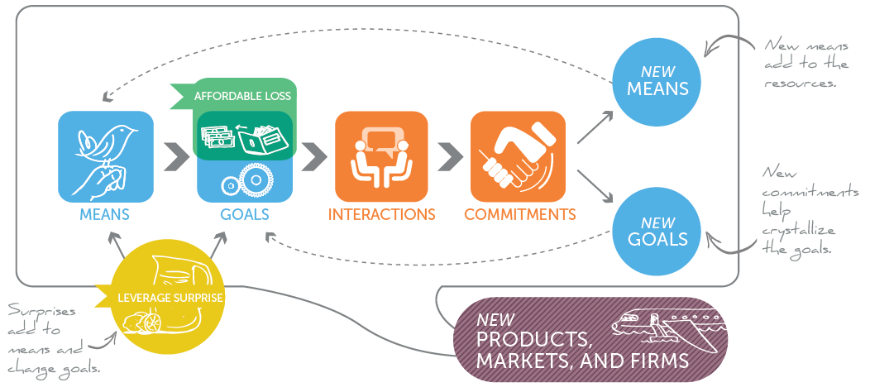

Slide 34
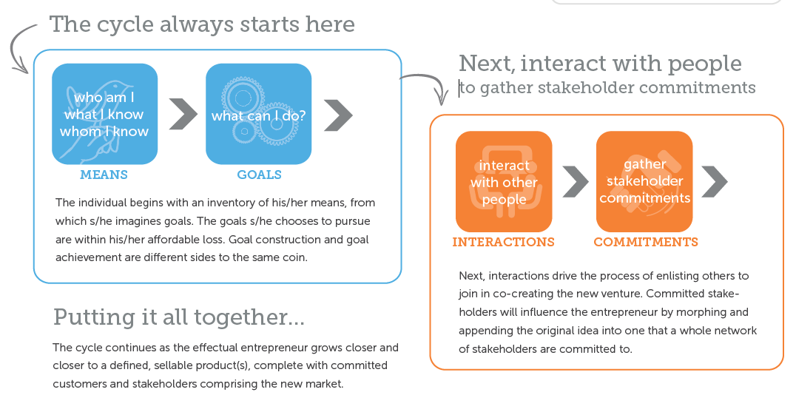

Slide 35
The Entrepreneurial Mind-set
EFFECTUATION
Entrepreneurs largely use an effectuation process. Which means they use
what they have= (who they are + what they know + whom they know)
and select among possible outcomes.

Slide 36
The Entrepreneurial Mind-set
Principles of effectuation
The patchwork quilt principle
The affordable loss principle
The bird-in-hand principle
The lemonade principle
The pilot-in-the-plane principle

Slide 37

Patchwork Quilt {form partnerships }
Expert entrepreneurs build partnerships with self-selecting stakeholders.
By obtaining pre-commitments from key partners early on in the venture,
They reduce uncertainty and co-create the new market with its interested participants

Slide 38
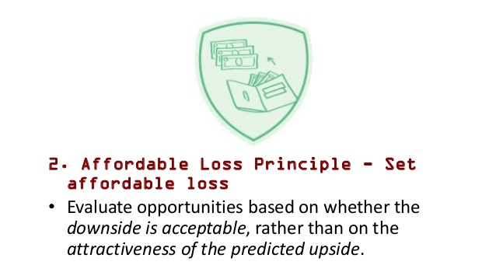
The affordable loss principle {focus on the downside risk }
This principle prescribes committing in advance to what one is willing to lose rather than concentrating on the calculations about expected returns to the investment
E.g. what is acceptable loss depends on the entrepreneur’s current financial condition and psychological preparedness to bear a certain loss level. The entrepreneur should experiment in the environment of uncertainty but with a known maximum loss level.

Slide 39

The bird-in-hand principle {start with your means}
Create opportunities and perform actions based on the resources available here and now by asking:
Who am I?
What do I know?
Who do I know?
i.e.
Who am I+ what I know + whom I know = WHAT I HAVE
A bird in hand is worth two in the bush

Slide 40

The lemonade principle {leverage contingencies }
This principle prescribes leveraging surprises for benefit rather than trying to avoid them, overcome them or adapt them.
In other words, try and overcome threats with opportunities.
If you come across a lemon, make lemonade out of it.
It is possible to look at the flip side of most threats to find or generate opportunities

Slide 41

The pilot-in-the-plane principle { control v. predict}
By focusing on activities within their control, expert entrepreneurs know their actions will result in the desired outcomes.
An effectual worldview is rooted in the belief that the future is neither found nor predicted, but rather made.

Slide 42
The Entrepreneurial Mind-set
In summary, all the above principles enable entrepreneurs to put themselves in control of their ventures:
Not relying on some preprogrammed flight plan
Hence, entrepreneurs should not only navigate the entrepreneurial environment but also appreciate its dynamism and exploit unexpected events

Slide 43
The Entrepreneurial Mind-set
2. COGNITIVE ADAPTABILITY
Describes the extend to which entrepreneurs are dynamic, flexible, self-regulating and engaged in the process of generating multiple decision frameworks focused on sensing and processing change in the environment and then acting on them.
E.G. generating
Comprehension questions (what do I want to achieve with the creation of this firm?)
Connection questions (how is this problem similar to other problems I have solved before?)
Strategic questions (what strategy/tactic can I use to solve this problem?)
Reflection questions (generating your own feedback: what am I doing?, does it make sense? etc.)

Slide 44
The Entrepreneurial Mind-set
3. ABILITY TO LEARN FROM FAILURE
Loss orientation: an approach to grief recovery that involves working through, and processing some aspect of the loss experience and, as a result of this , breaking emotional bonds to the object lost
Restoration orientation: an approach to grief recovery based on both avoidance and proactiveness toward secondary sources of stress
E.g. joining the unemployment line, selling the house, requiring the children to change school, answering the ‘why’ questions

Slide 45
Common Myths About Entrepreneurs
Myth 1: Entrepreneurs Are Born, Not Made
This myth is based on the mistaken belief that some people are genetically predisposed to be entrepreneurs.
Result of hundreds of stud­ies on the psychological and sociological makeup of entrepreneurs is that entrepreneurs are not genetically different from other people
Whether someone does or doesn't is a function of the environment, life experiences, and personal choices.
However, studies indicate that people with parents who were self-employed or had direct observation of other entrepreneurs are likely to be­come entrepreneurs.

Slide 46
Myth 2: Entrepreneurs Are Gamblers
A second myth about entrepreneurs is that they are gamblers and take big risks.
The truth is, entrepreneurs are usually moderate risk takers, as are most people.
This finding is affirmed by The Hartford's 2013 Small Business Success Study.
The study conducted a survey of 2,600 business owners. A total of 79 percent of the participants rated themselves as conservative rather than risky.

Slide 47
Myth 3: Entrepreneurs Are Motivated Primarily by Money
What is your view?

Slide 48
Myth 4: Entrepreneurs Should Be Young and Energetic
Entrepreneurial activity is fairly evenly spread out over age ranges (Kauffman Foundation and LegalZoom, 2012)
It is important to be energetic
Investors often cite the strength of the entrepreneur (or team of entrepreneurs) as their most important criterion in the decision to fund new ventures.
In fact, venture capi­talists often express that they would rather fund a strong entrepreneur with a mediocre business idea than fund a strong business idea and a mediocre entrepreneur.
What makes an entrepreneur "strong" in the eyes of an investor is experience in the area of the proposed business, skills and abilities that will help the business, a solid reputation, a track record of success, and passion about the business idea.
The first 4 of these 5 qualities favor older rather than younger entrepreneurs.

Slide 49
Myth 5: Entrepreneurs Love the Spotlight
What do you think?

Slide 50

ANY QUESTION?

Slide 51
THANK YOU

